Slide 1







“Loser” or “Winner”?
Yunwei Zhang
Qixian Zhao

Slide 2
Raise Problem
Data Collection and Cleaning
Procedure
Data Analysis and Visualization
Conclusion and Improvement

Slide 3
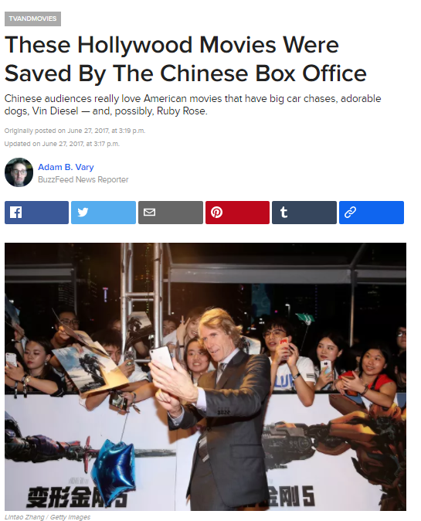
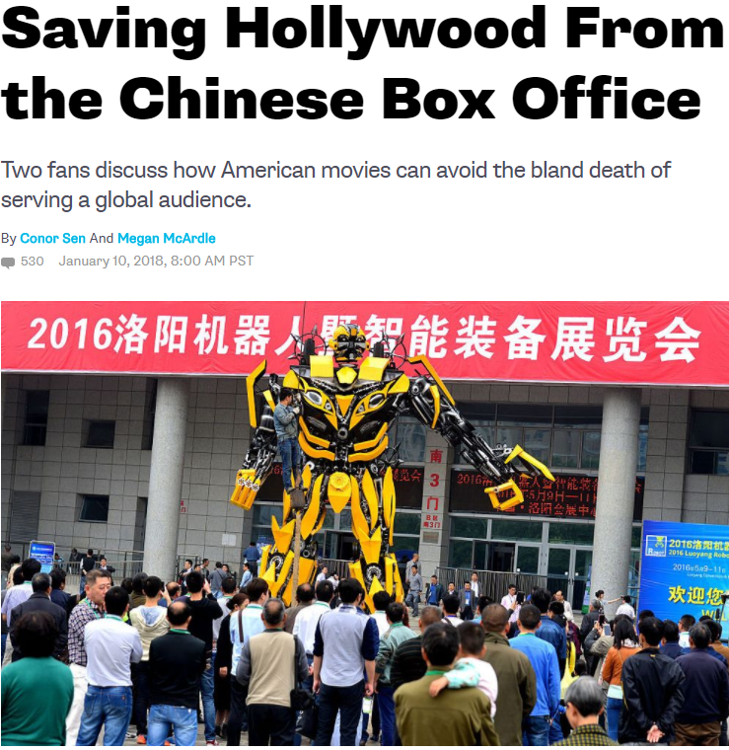
Raise Problem

Slide 5






Data Collection and Cleaning
Resource: Mojo, The Numbers, IMDb, douban, Twitter, Weibo

Slide 6

Data Collection and Cleaning
Movie Information
Box office and Rank(USA, China, Worldwide)
Cast Crew(director, leading actors)
Movie Rating
douban(assume all from Chinese audience)
IMDb(assume all American audience)
Movie Popularity
Weibo(represent popularity in China based on Reading and Dissussion)
Twitter(represent popularity America based on Followeres and Likes)

Slide 7

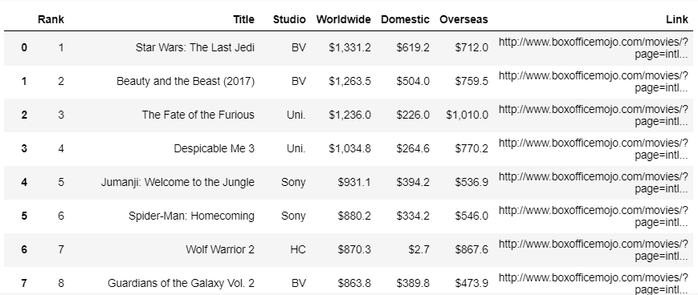
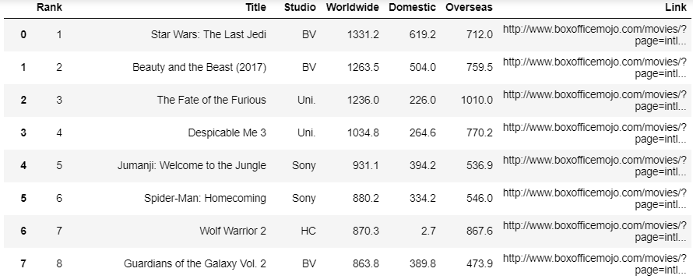
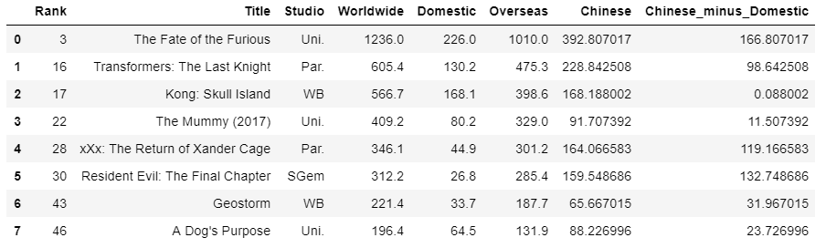
Data Collection and Cleaning

Slide 8
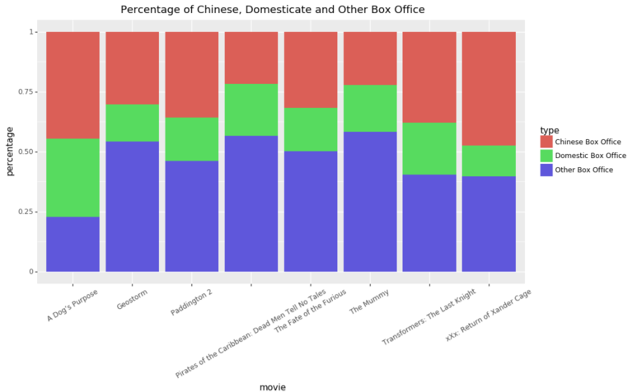
Data Analysis and Visualization

Slide 9
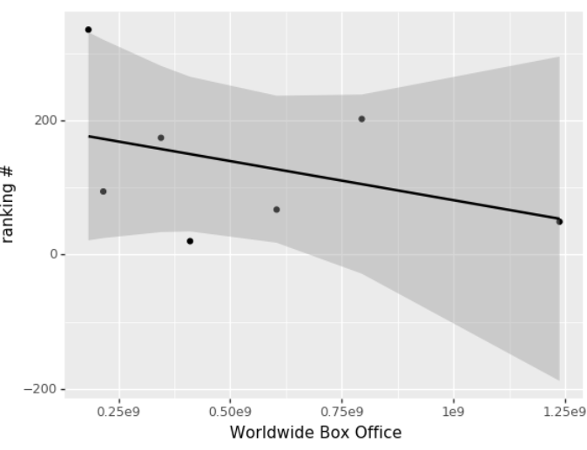
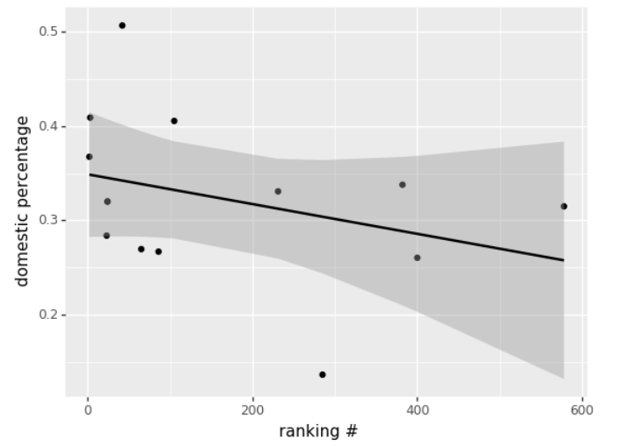
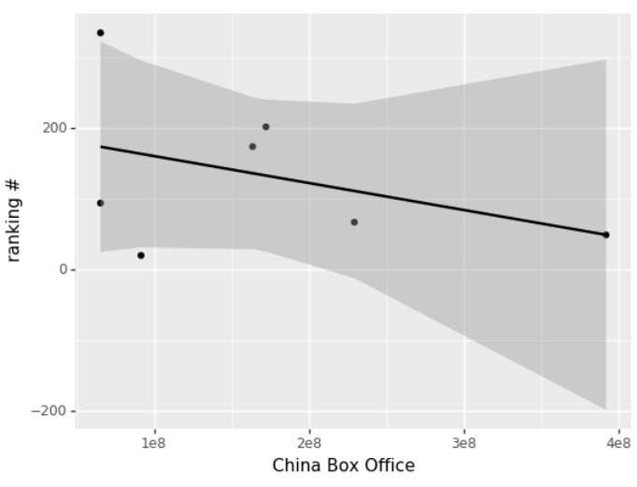
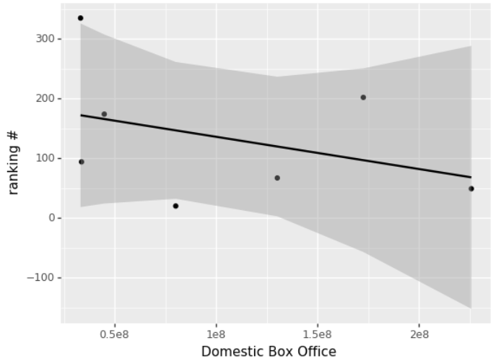
Data Analysis and Visualization

Slide 10
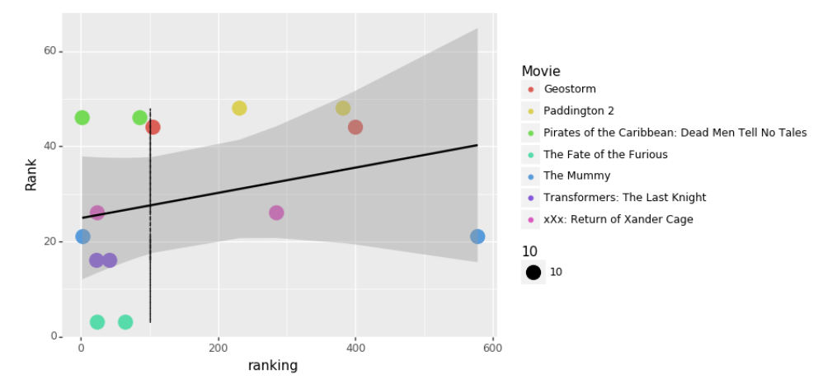
Data Analysis and Visualization

Slide 11
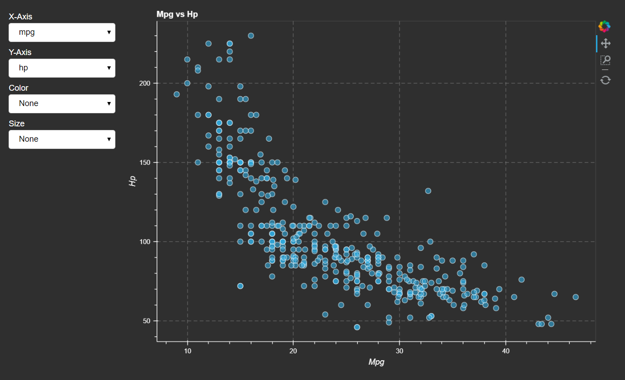
Data Analysis and Visualization

Slide 12
Conclusion director outlier: Xrander Case

Slide 13
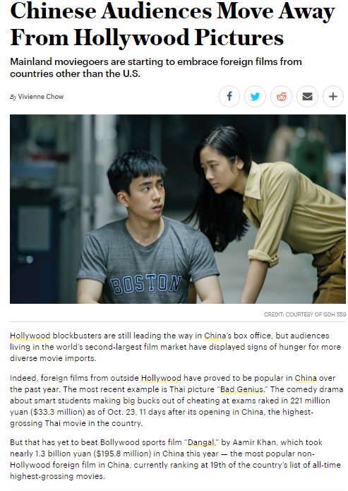
Improvement

Slide 14







Thank you!

